Slide 1
Internship Presentation 2
Name: Arbaaz Khan
Roll No.: 17
Intern @ Elite Software

Slide 2
Learnings in the Month of February
Python:
Learned python language starting with the basic concepts such as Variables, Data types, Operators, Python data structure to more advanced topics such as Classes and Function, GUI Programming.
Django:
Django by learning the basics of web development, including HTML, CSS, and JavaScript. From there, I gradually worked my way up to Django, starting with the fundamental concepts such as URLs, views, templates, and models. I gained a deeper understanding of the Model-View-Controller (MVC) architecture and how it is implemented in Django.

Slide 3
Some Important Django Commands
Creating a new Django project: django-admin startproject project_name
Creating a new Django application within a project: python manage.py startapp app_name
Starting the Django development server: python manage.py runserver
Creating database tables for the application: python manage.py migrate
Creating a superuser for the Django admin: python manage.py createsuperuser
Running unit tests for the application: python manage.py test app_name
Creating a new migration for changes to models: python manage.py makemigrations
Applying migrations to the database: python manage.py migrate
Displaying a list of available commands: python manage.py help

Slide 4
Files that Django Automatically Generates for Faster development Process:
When we Create a Django Project it will create python files for faster development
Some Files are-
Settings.py : configuration file that stores all the settings and configuration variables for a Django project
Models.py: models.py is a Python module that defines the structure of the database tables for a Django application
Views.py:It is responsible for processing incoming HTTP requests, interacting with models to retrieve and modify data, and returning HTTP responses.
Urls.py:defines the URL patterns or routes for a web application. It maps the requested URL to the appropriate view function, which will generate the HTTP response.
Manage.py: This is the command-line utility for interacting with your project. You can use it to run development servers, create database tables, and execute other management tasks.

Slide 5
Some tasks Related to Python and Django done in the month of February
Task: To Generate QR code for any given link in python
Implementation:
The Program Implemented using Python Tkinter library for the user interface and the QR code and other libraries for generating and saving the QR codes.
When the user enters the title and URL and clicks the "Enter" button, the program generates a QR code image and saves it to a file with the given title. The "View QRCODE" button displays the generated QR code in a GUI window.

Slide 6
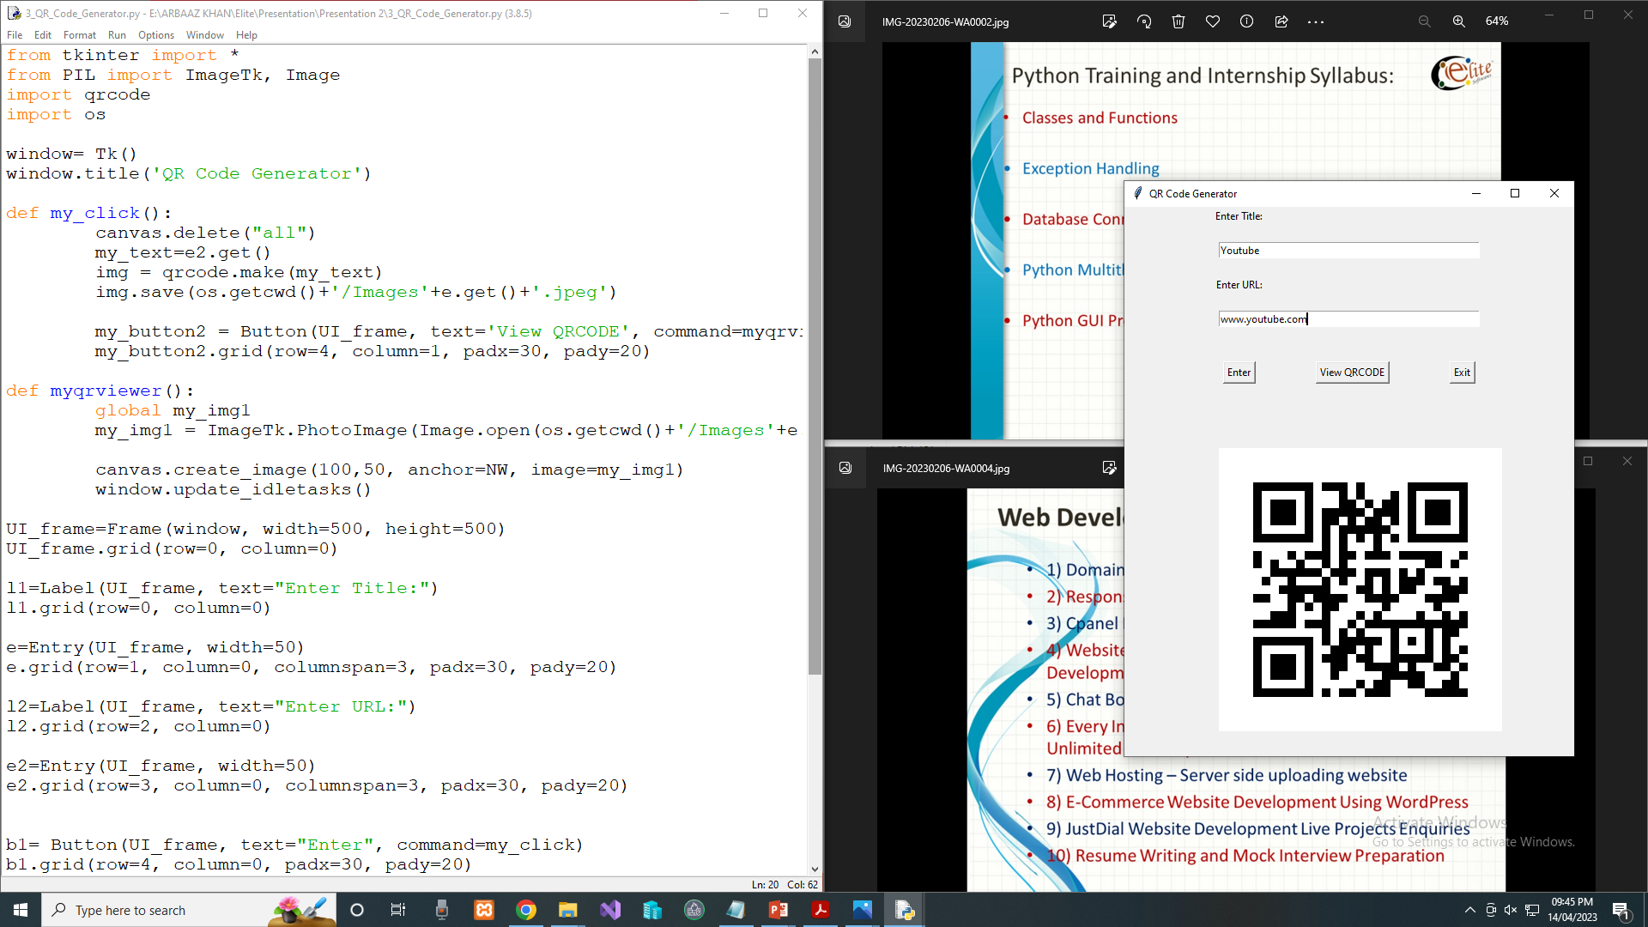
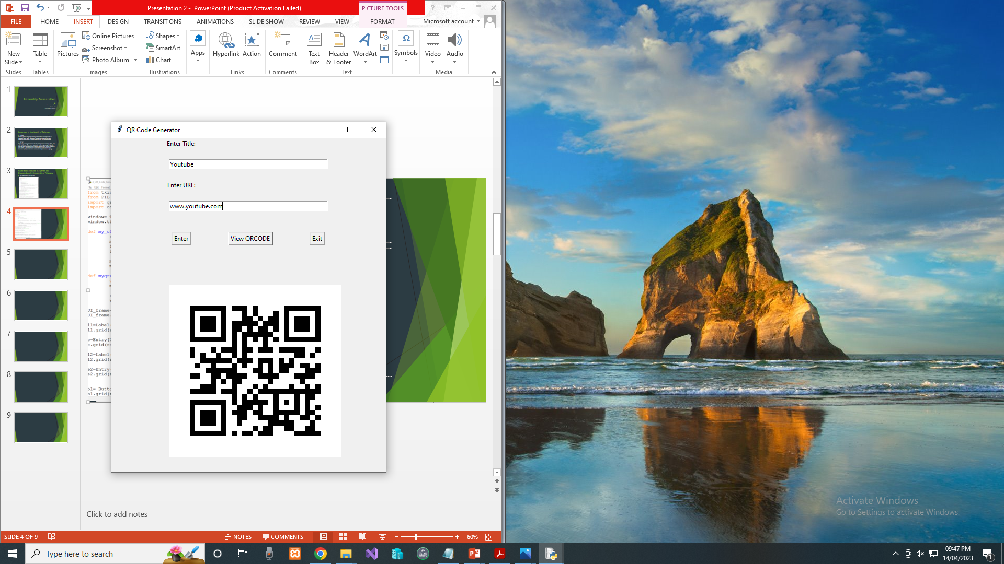

Slide 7
Python-Django Task
Task: To Change the Content of Static webpage (Destination Part) to Dynamic webpage using Django.
Implementation:
Steps Followed to accomplish the given task:
1. Creating Database Schema in Models.py
2. Enable Database in Settings.py
3. Mapping Urls to include app urls
4. Creating Views and passing Database object as parameter
5. Making changes in our html file (changing static content to dynamic)
6. Adding Content by using Django Admin Panel
7. Verifying in postgreSQL using pgAdmin.

Slide 8
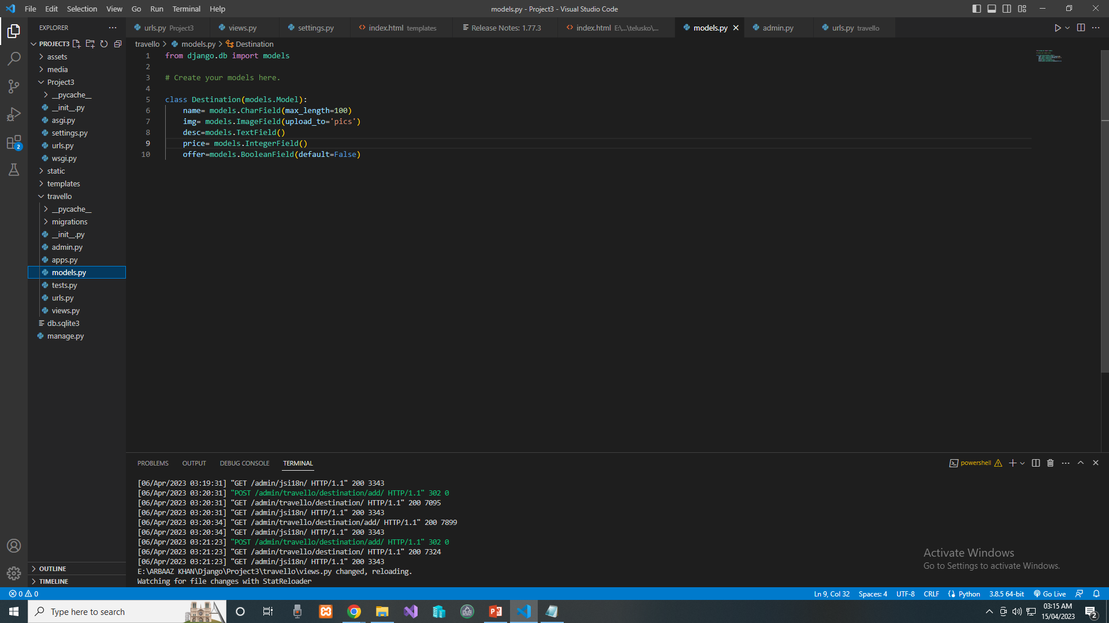
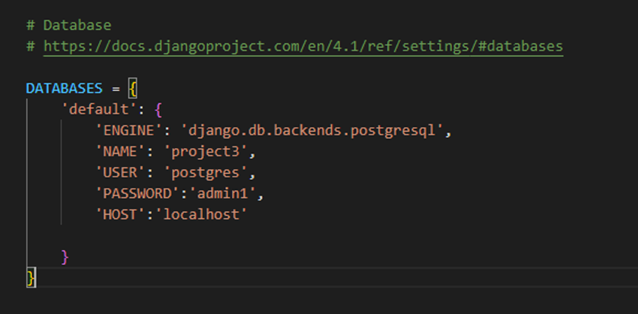
Models.py
Settings.py

Slide 9
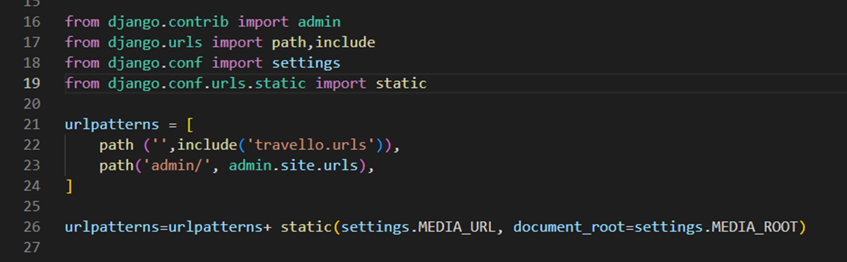
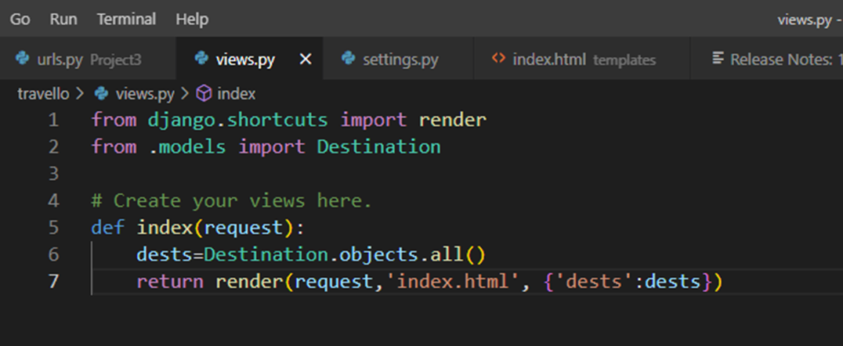
urls.py
Views.py

Slide 10
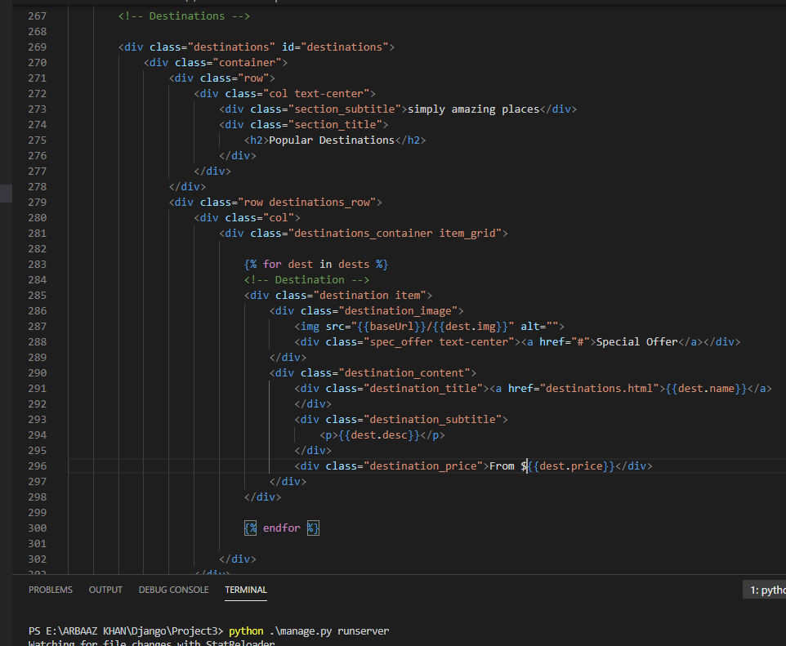
Making changes in Index.html file.

Slide 11
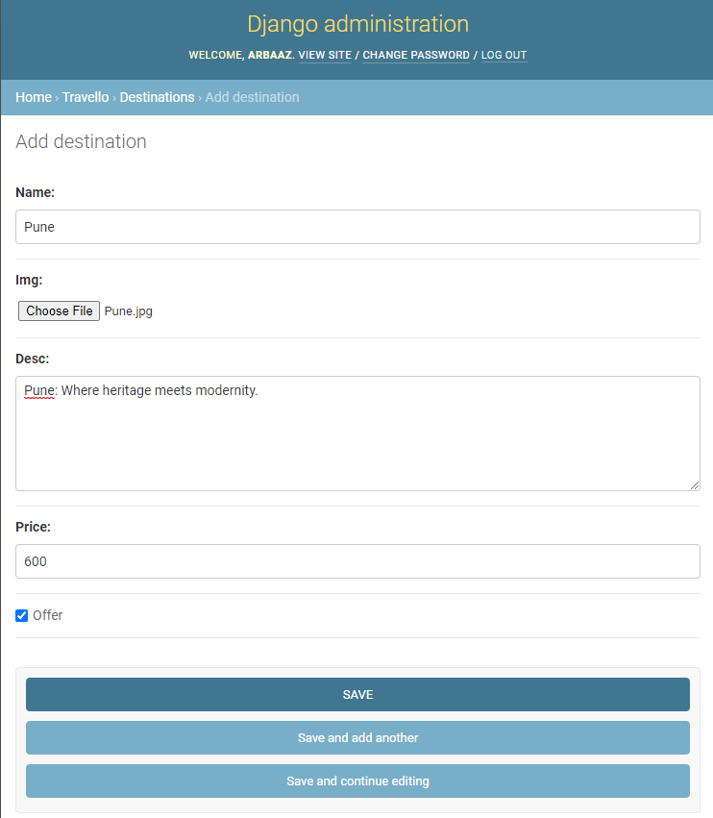
This is Django Adminstration panel from here we can add details for our destination like Name, Image, Description, Price, and whether it is in offer or not

Slide 12
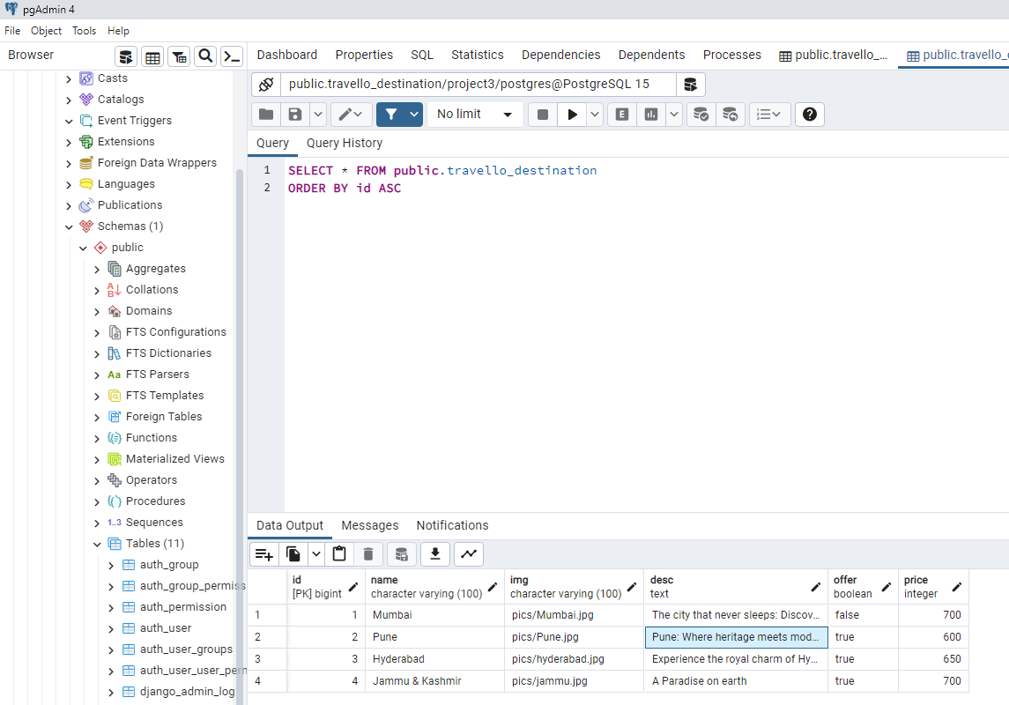
The data which we will enter in Django Administration panel will be added in postgreSQL

Slide 13
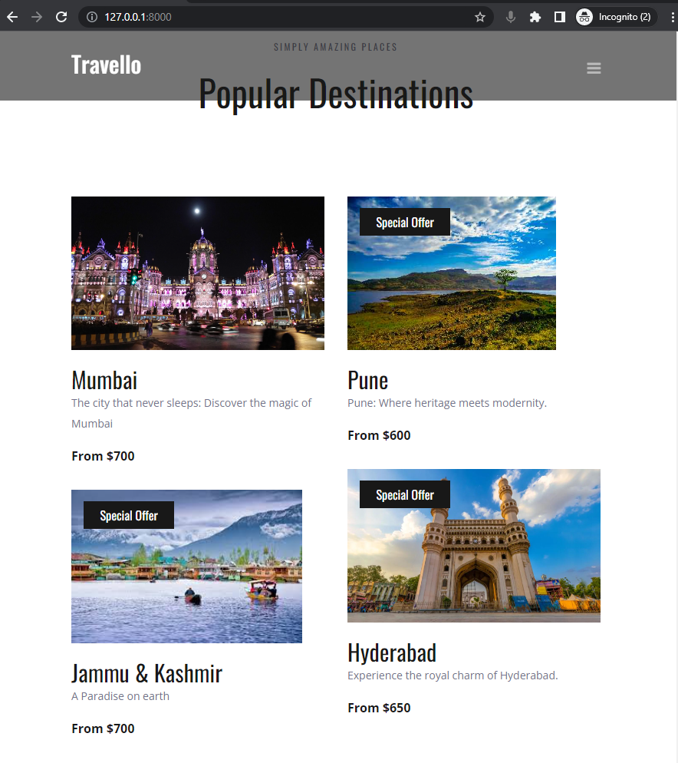
Finally when we run this Command
>Python manage.py runserver
Our Project will be running on localhost and now our content for destination part is dynamic and responsive.

